Slide 1
Presentation
on
PFMS – SPMU
HIMACHAL

Slide 2
PUBLIC FINANCIAL MANAGEMENT SYSTEM
( P F M S )
O/o Controller General of Accounts
Ministry of Finance, New Delhi
Welcome
all Participants
to
the Workshop
http://pfms.nic.in

Slide 3
What is PFMS
Public Financial Management System is a Central Sector Scheme of Ministry of Finance. PFMS is a web-based online transaction system for fund management and e-payment by using Core Banking Solutions (CBS) of banks
Earlier (w.e.f. 01/04/2008) known as Central Plan Scheme Monitoring System (CPSMS) the Scheme has been renamed as Public Financial Management System (PFMS) from 01/04/2014.
The URL address of PFMS is https//pfms.nic.in

Slide 4
About PFMS
Report utilization under these schemes at different levels of implementation on a real time basis
Being implemented by the Office of the Controller General of Accounts (CGA).
Technical support viz. application development, database administration, hosting of portal etc is provided by National Informatics Centre (NIC).

Slide 5
PFMS PORTAL
The PFMS is being implemented through the web based application developed and
deployed by the office of the Controller General of Accounts .
PFMS Portal can be accessed by loging through http://pfms.nic.in
The detailed information about PFMS is available on home page of this Portal.
All details of releases of fund & expenditure are captured on the Portal.

Slide 6
Objectives of PFMS
Monitoring of flow of funds from Centre to the lowest level of implementation- both for fund flows to State Consolidated Funds & to Implementing Agencies.
Payment to ultimate beneficiaries through banking channel
Capturing component-wise expenditure on real time basis at all tiers of implementation, including Panchayat and village levels.

Slide 7

Objectives of PFMS
Decision Support System (DSS) to all levels of programme administration (Centre, State, District & Local Government, i.e. Panchayat / Municipality).
Information of bank balances / funds in the pipeline to facilitate “just-in-time” payment to implementing agencies leading to reduction of borrowings of Government of India.
Enhance transparency & accountability in public expenditure.

Slide 8
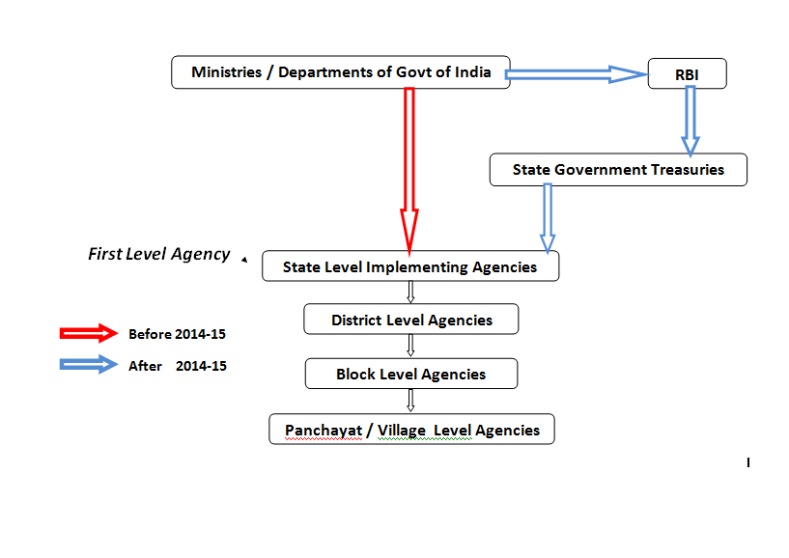
Flow of funds before and after restructuring of CSS (2014-15)

Slide 9
MONITORING OF FUNDS THROUGH
PFMS-TREASURY INTERFACE

Slide 10
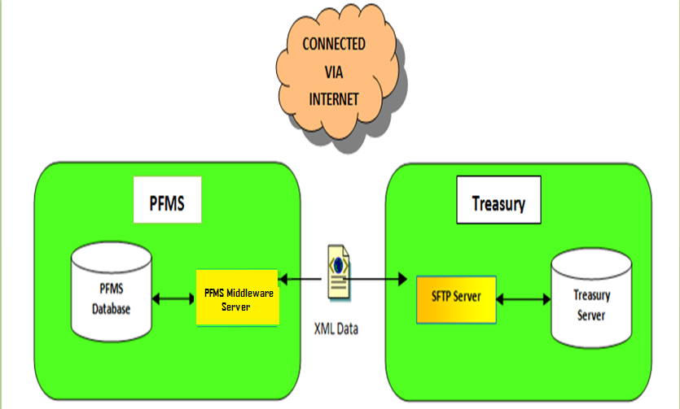
DATA EXCHANGE-HIGH LEVEL DESIGN

Slide 11
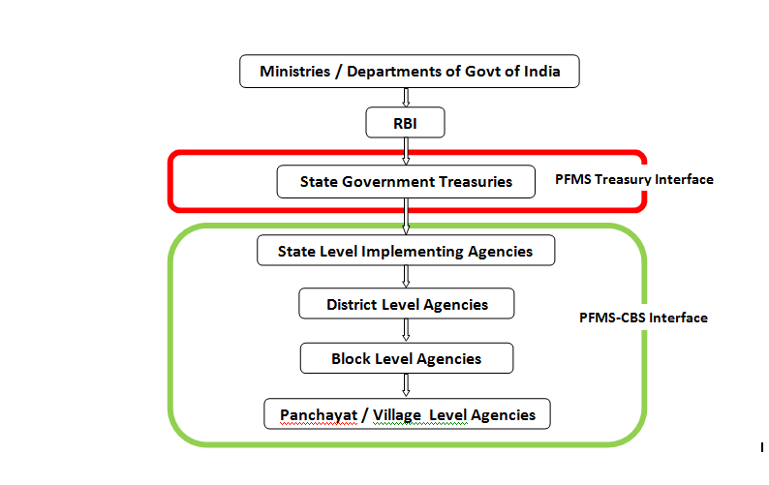
Monitoring Utilisation of funds

Slide 12
Interface with Different Systems – Bank Interface
Bank Integration of PFMS with Core Banking Solution (CBS) complete in respect of 148* banks-
  All Public Sector Banks, RRBs, major private banks, some co-operative banks, India Post and Reserve Bank of India.
  This facilitates-
    Near real-time Bank Account Validation.
    Fund Transfer.
    Access to View Bank Balances of Implementing Agencies.
The system is configured to make e-payment though banks using Digital Signature, Corporate Internet Banking (CINB) and Payment Print Advice.

Slide 13

Account Validation Response
Daily Transaction Data
PFMS–CBS Integration
PFMS-CBS Interface
PFMS Application
Cycle Period
Near Real Time
Account Validation / Confirmation of Transaction
Bank CBS System

Slide 14
State Project Management Unit
The State Project Management Unit to be created in each State will have the functions of coordination, customization of State specific requirement, monitoring of implementation and capacity building in States.

Slide 15
Sr. No | User type | Designation | To be created and approved by | Role on PFMS SPMU modules
1 | SPMU Controller | Joint Controller General of Accounts | Root User CPMU | Creation, Approval & Management of state Project Cell User and State Finance Department user
2 | State Project Cell User | Account Officers / Assistant Account Officers (AOs & AAOs O/o CGA) | SPMU Controller | (1) Creation and configuration of State Schemes (2) Management of agencies beyond the role assigned to State Scheme Manager (in exceptional fields)
3 | State Finance Department | Secretary Finance Department (or Equivalent) | SPMU Controller | Creation, Approval & Management of three users viz. (1) ‘Scheme Manager for State’ (2) ‘Agency approver Level 2’. (3) State Departmental MIS User
4 | State Scheme Managers | Concerned State Departmental Officer (Secretary / Under Secretary) – Scheme wise. | State Finance Department | Creating, Approving and Managing (editing, mapping) first level agencies registered in his State
5. | Agency Approver – Level 2 | Director / Dy Director / Treasury Officer | State Finance Department | Second level approver of First level agency
6. | State Departmental MIS User | Departmental Heads | State Finance Department | For viewing Reports.

Slide 16
Process Flow for Roll-out in State
STATE PROJECT MANAGEMENT UNIT(SPMU)
SPCU USER
State Finance Deptt. User
State Scheme Manager (Adm.Hds.)
Agency Approver Level-2 (Treasury Deptt.)
MIS Users
Creates
Manage
Approve
First Level Agency (State Level)
Creates , Approve, Manage
District Level (2nd Level)
Creates , Approve, Manage
Block Level (3rd Level)

Slide 17
ROLE OF
STATE SCHEME MANAGERS

Slide 18
SSM USER CREATION
User type | Designation | To be created And approved by | Role of PFMS SPMU modules
State Scheme Managers | Concerned State Departmental Officer (Secretary / Under Secretary) – Scheme wise. | State Finance Department | Creating, Approving and Managing (editing, mapping) first level agencies registered in his State

Slide 19
CREATION OF FIRST LEVEL AGENCIES
MANAGE/EDIT THE DETAILS OF AGENCIES
DEACTIVATION OF ACCOUNTS
ADD SCHEME COMPONENTS
PROVIDE INPUTS FOR SCHEME CONFIGURATION
MAPPING OF AGENCIES
VIEW OF VARIOUS REPORTS

Slide 20
Main modules of PFMS
1. Agency registration module:
  Agencies get mapped in scheme hierarchy.
  Level wise bank account balances & daily transactions available.
2. EAT module:
  Component-wise Fund Utilization available - Expenditure/Advances/Transfers.
  Account validation facility for ensuring exp. filing.
3. DBT Module:

Slide 21
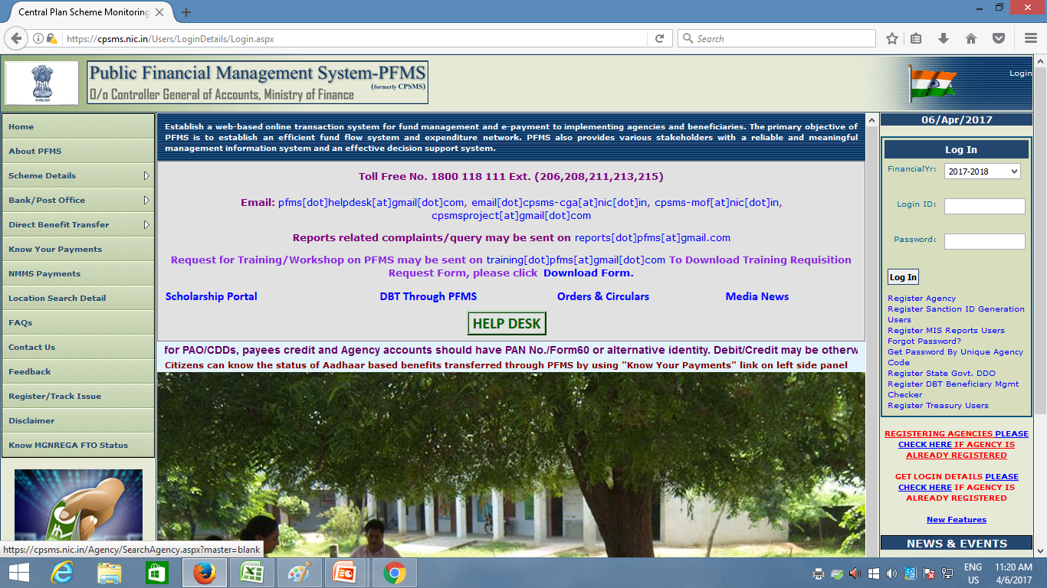
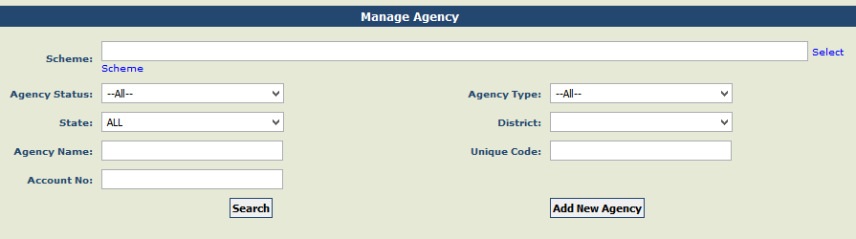
SEARCH AGENCY BEFORE CREATION

Slide 22
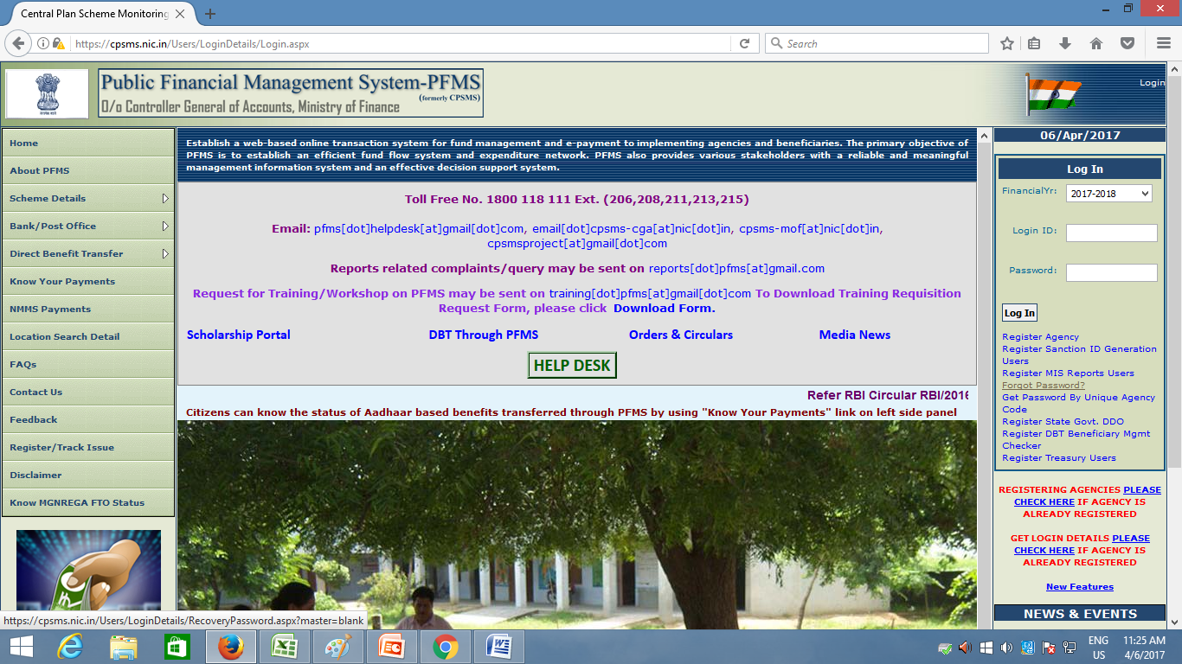
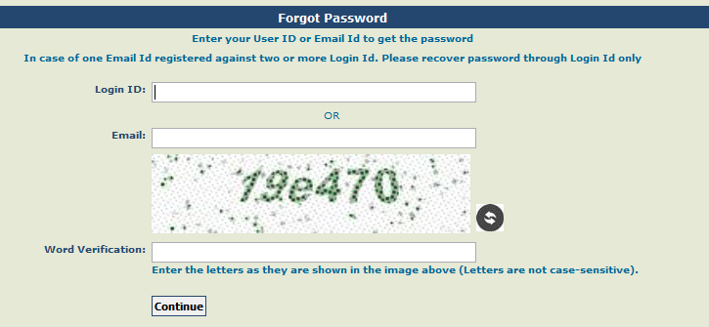
PASSWORD RECOVERY

Slide 23
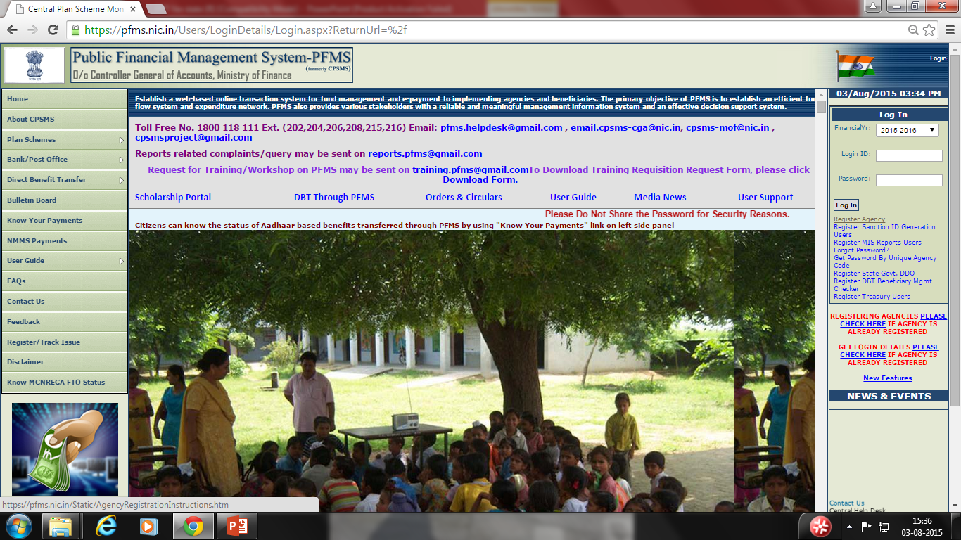
State level will be registered outside-register agency

Slide 24
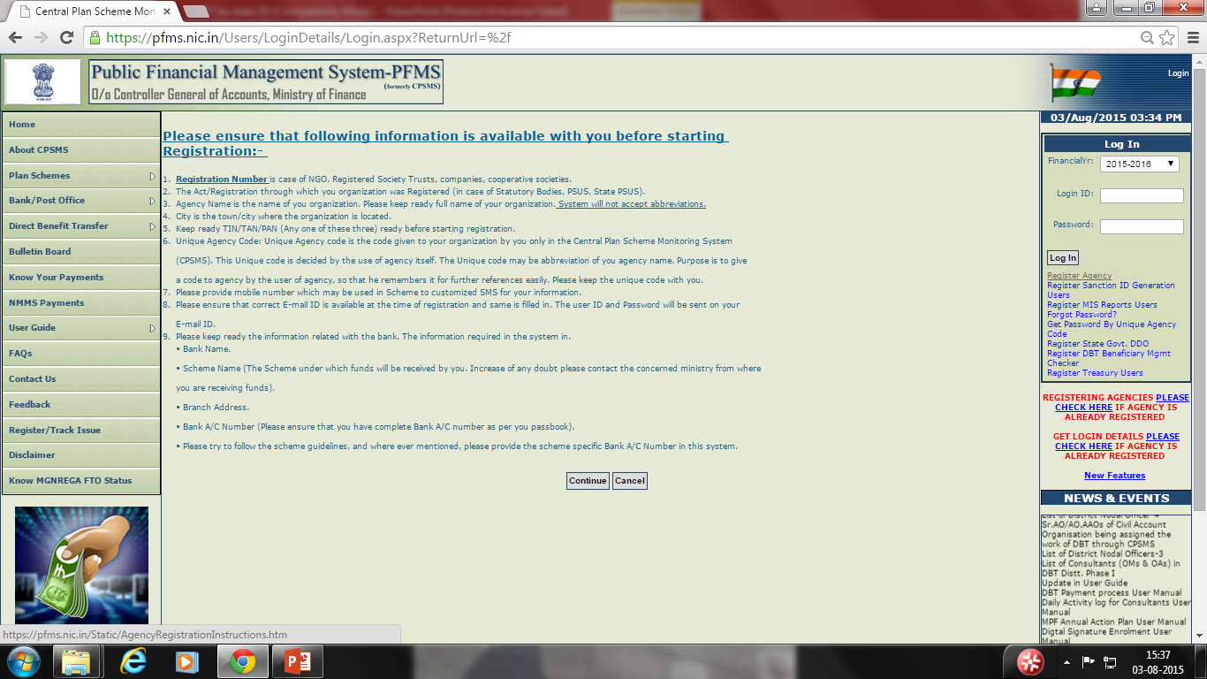
Click on register agency

Slide 25
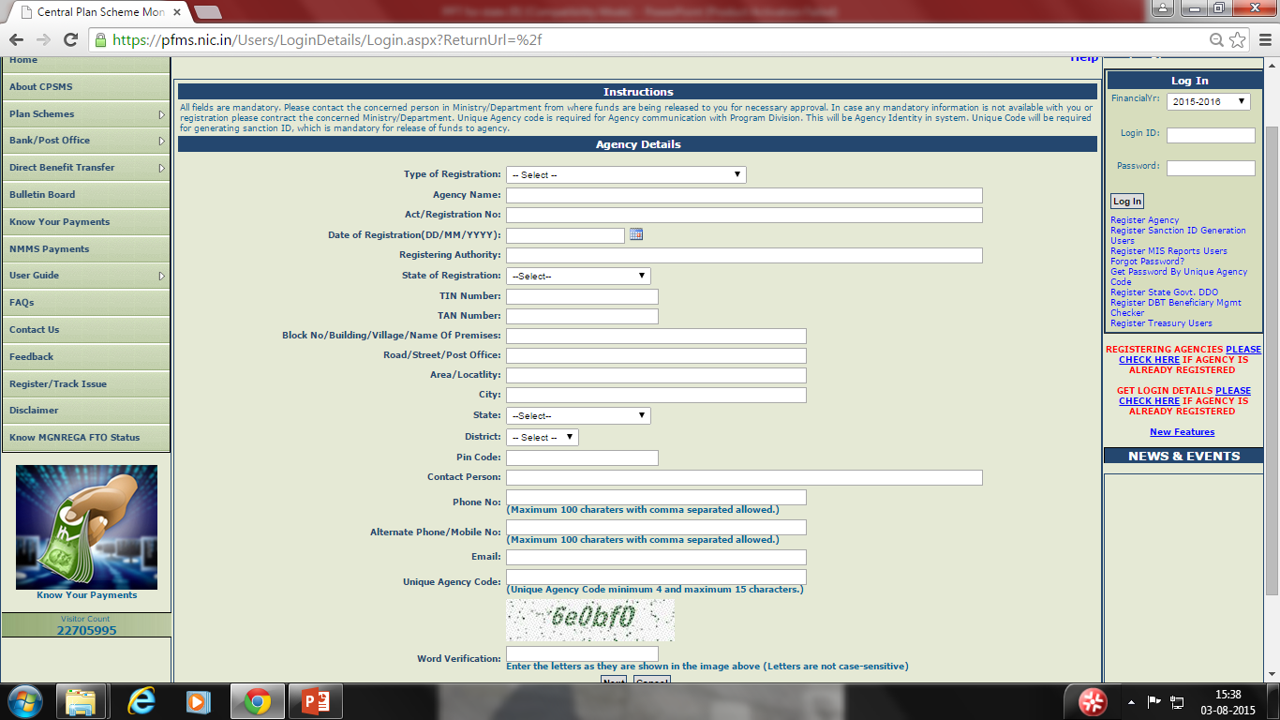
Enter required fields and click on next

Slide 26
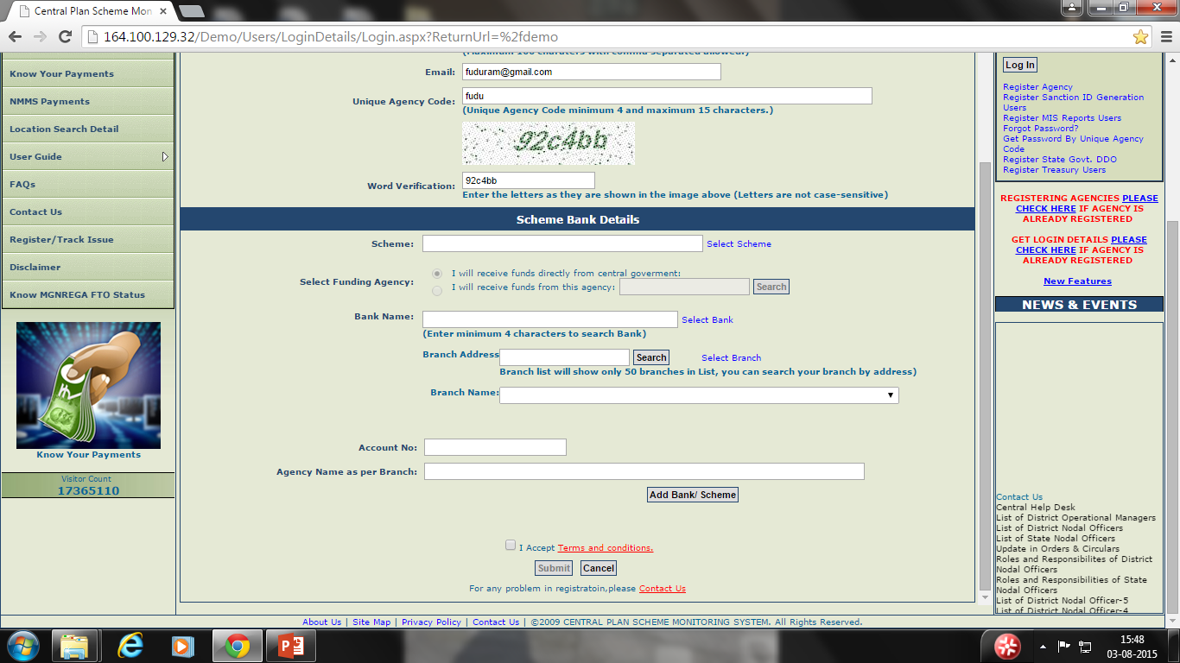
Enter scheme name bank details

Slide 27
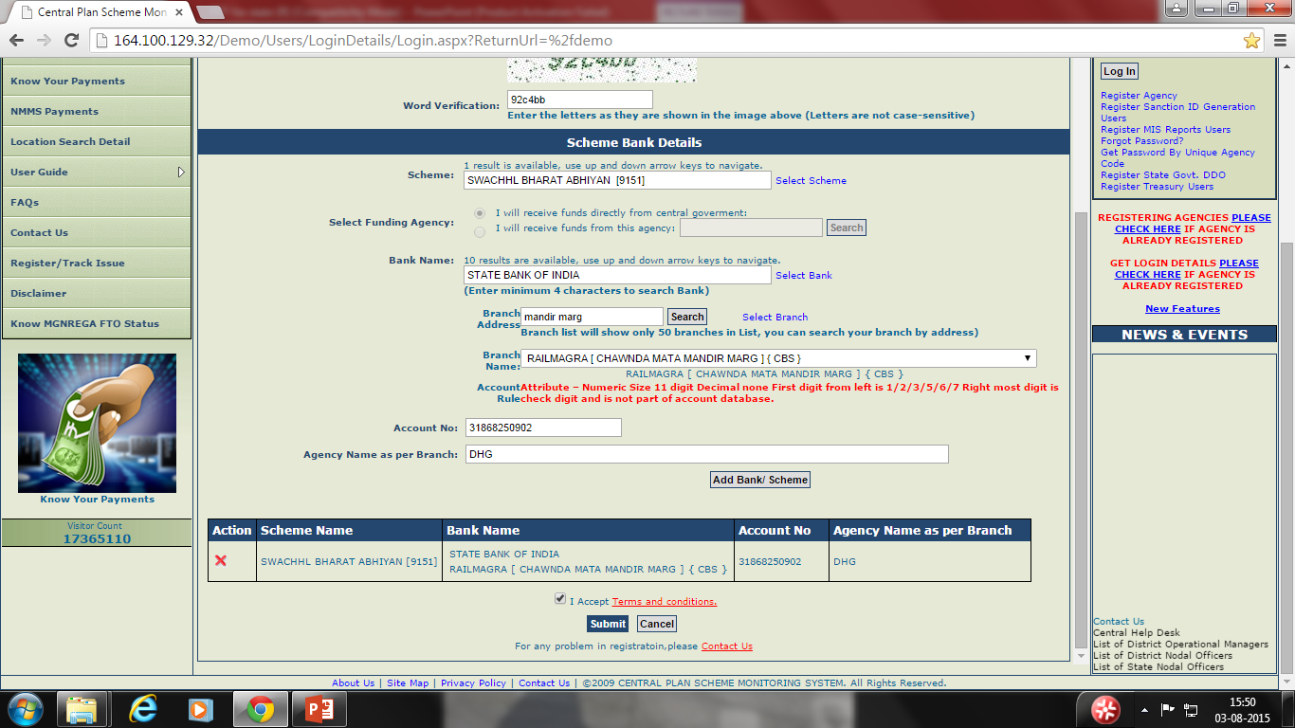
Enter bank details and submit

Slide 28
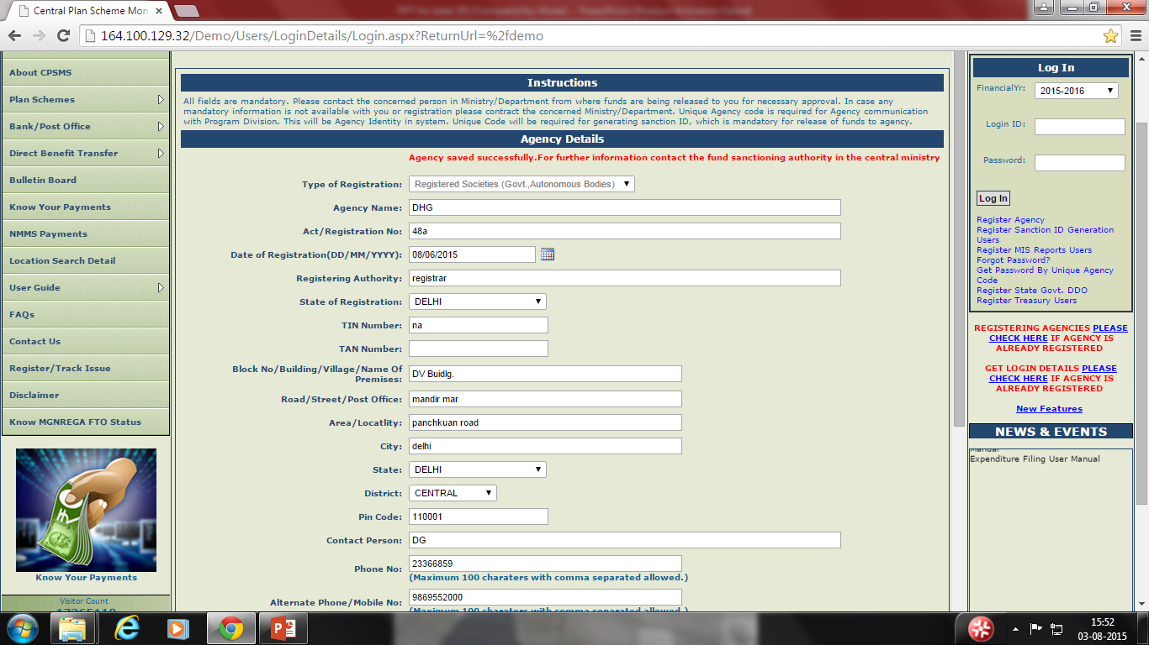
Accept terms & condition and submit-following message will appear

Slide 29
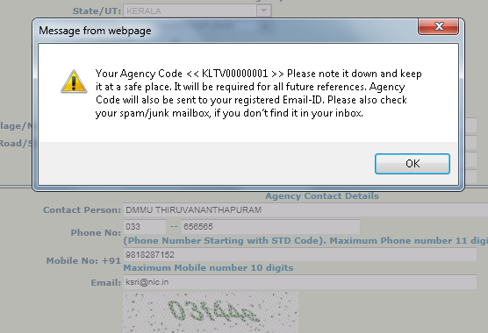
Agency Registration Process(3)

Slide 30
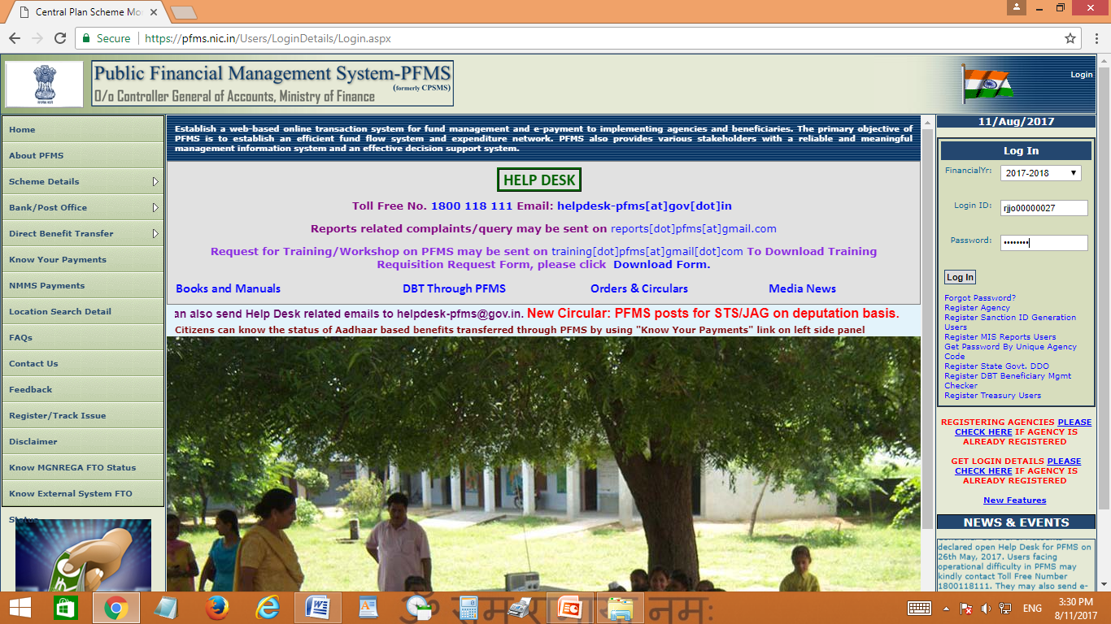
Creation of Maker and Checker User By Agency ADMIN

Slide 31
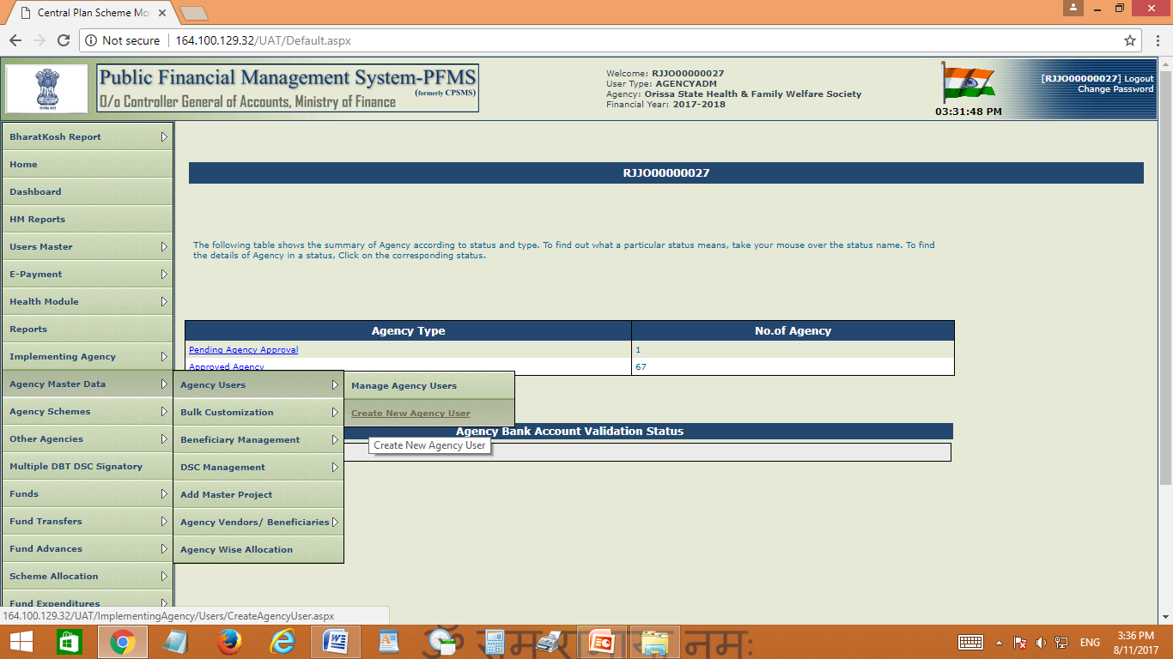

Slide 32
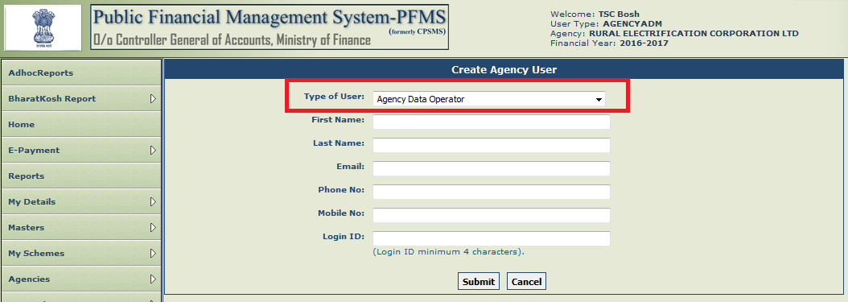
Creation of Maker User/Data Operator

Slide 33
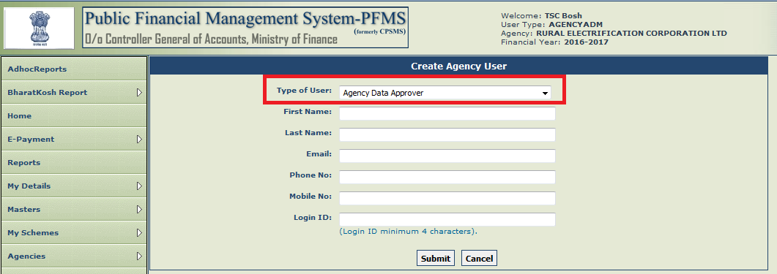
Creation of Checker/Approver User by Agency ADMIN User

Slide 34
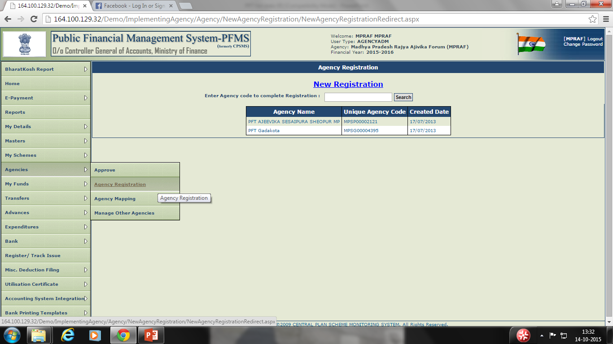
Registration of Child Level Agency.

Slide 35
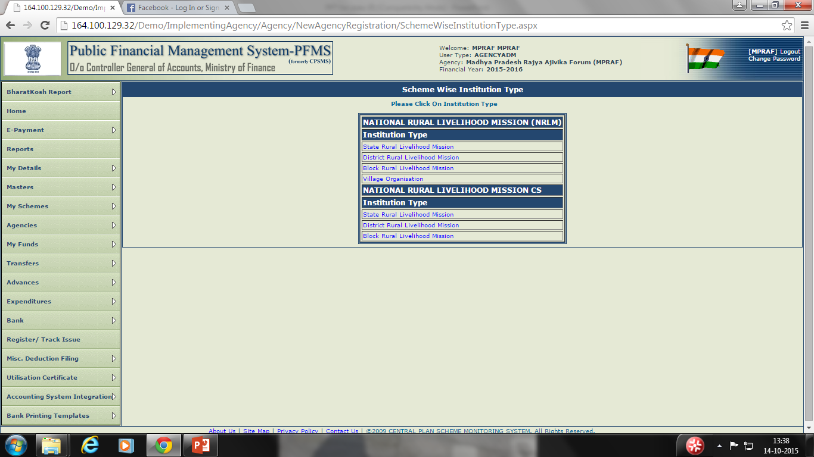

Slide 36
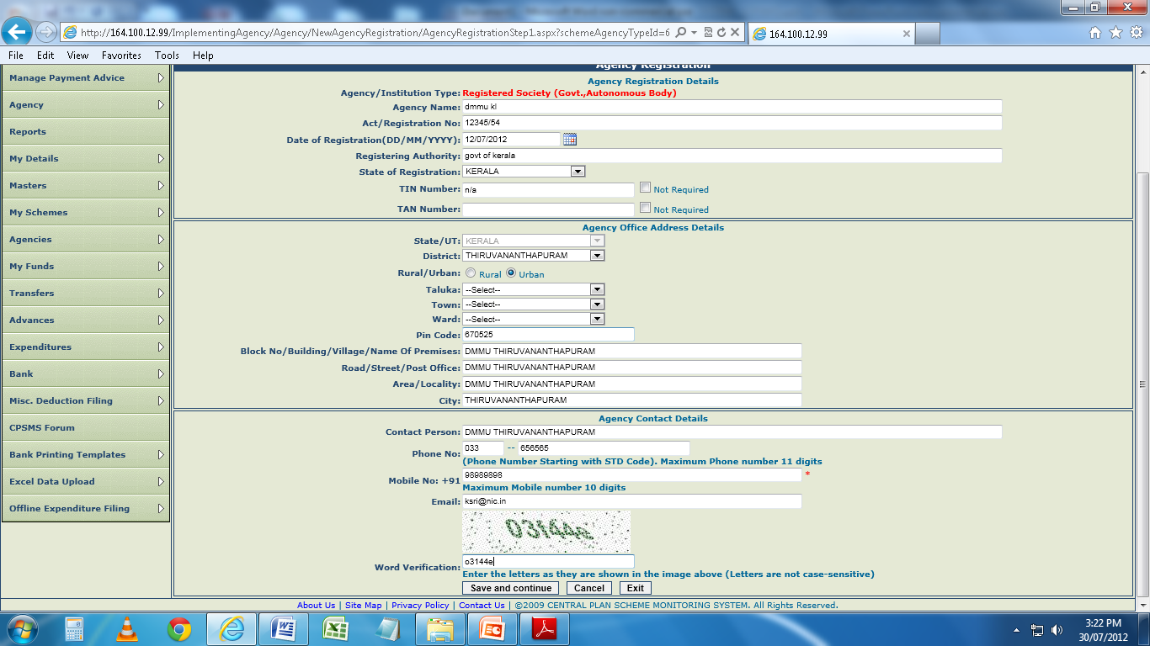

Slide 38
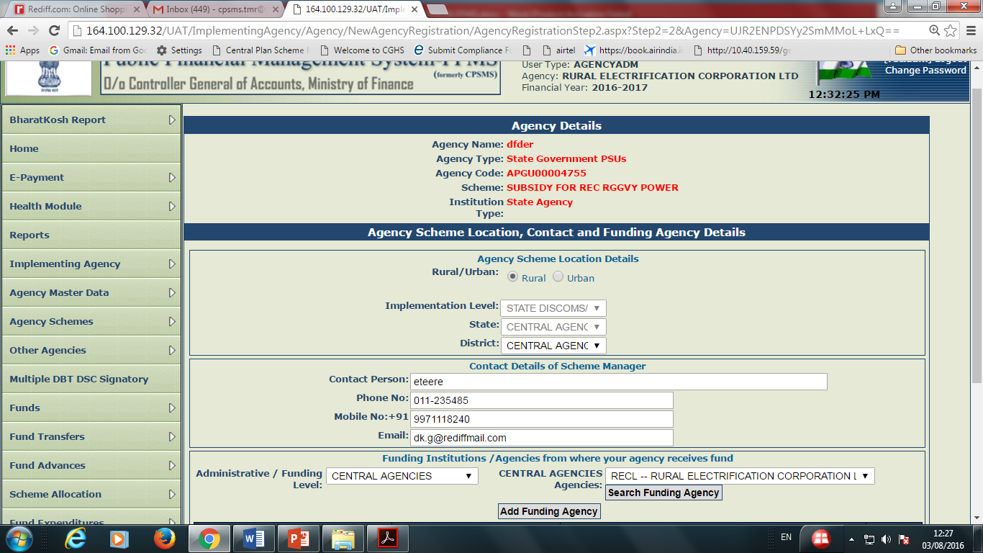

Slide 39
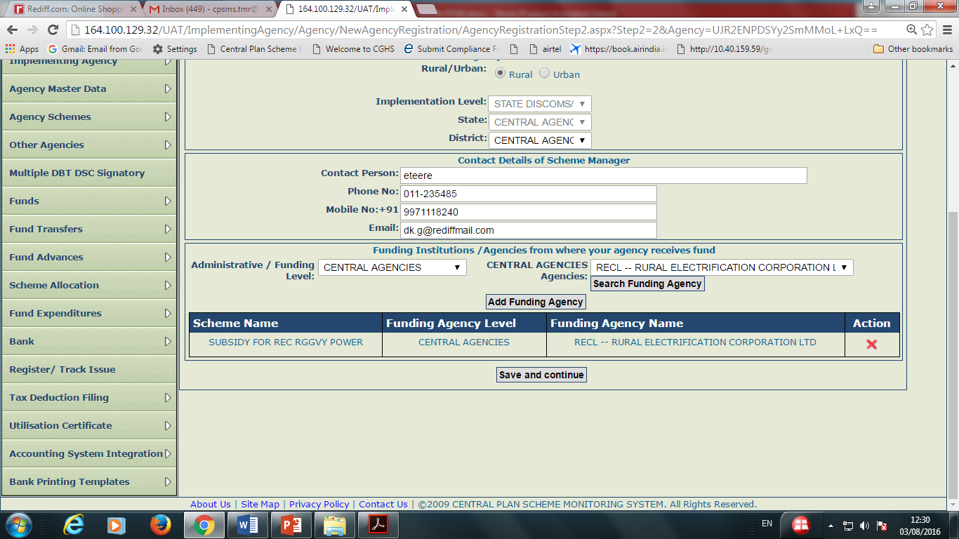

Slide 40
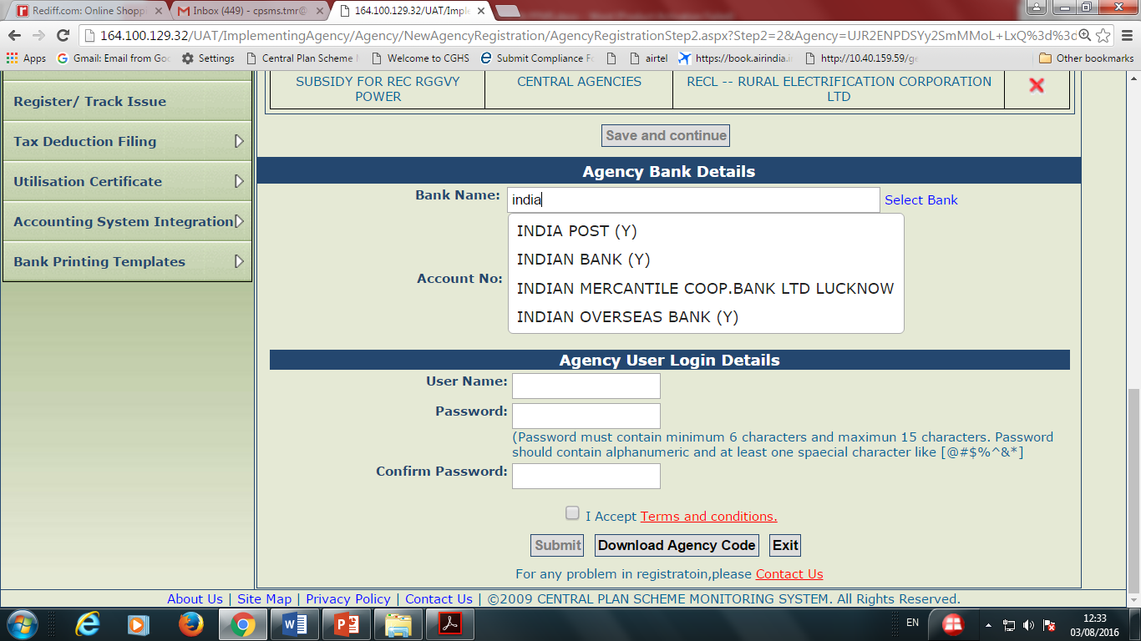

Slide 41
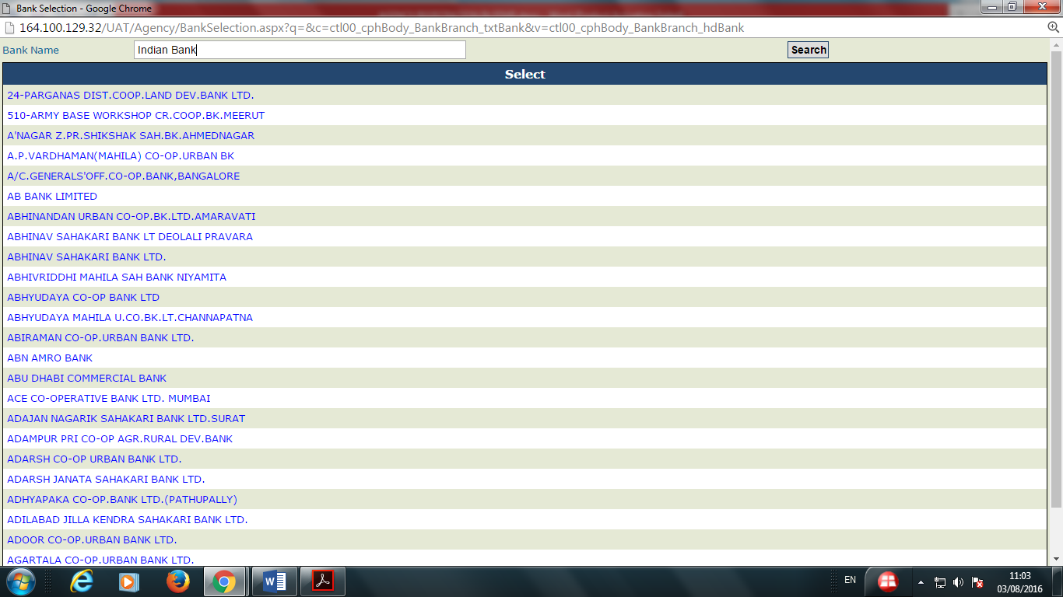

Slide 42
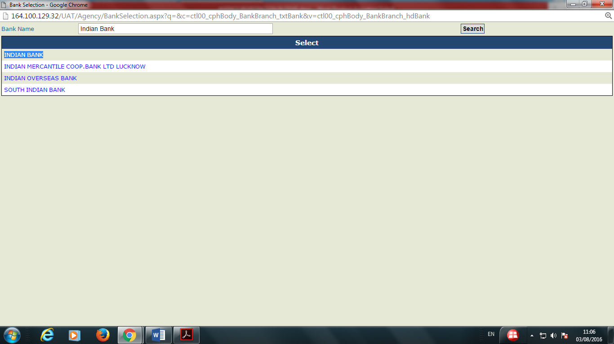

Slide 43
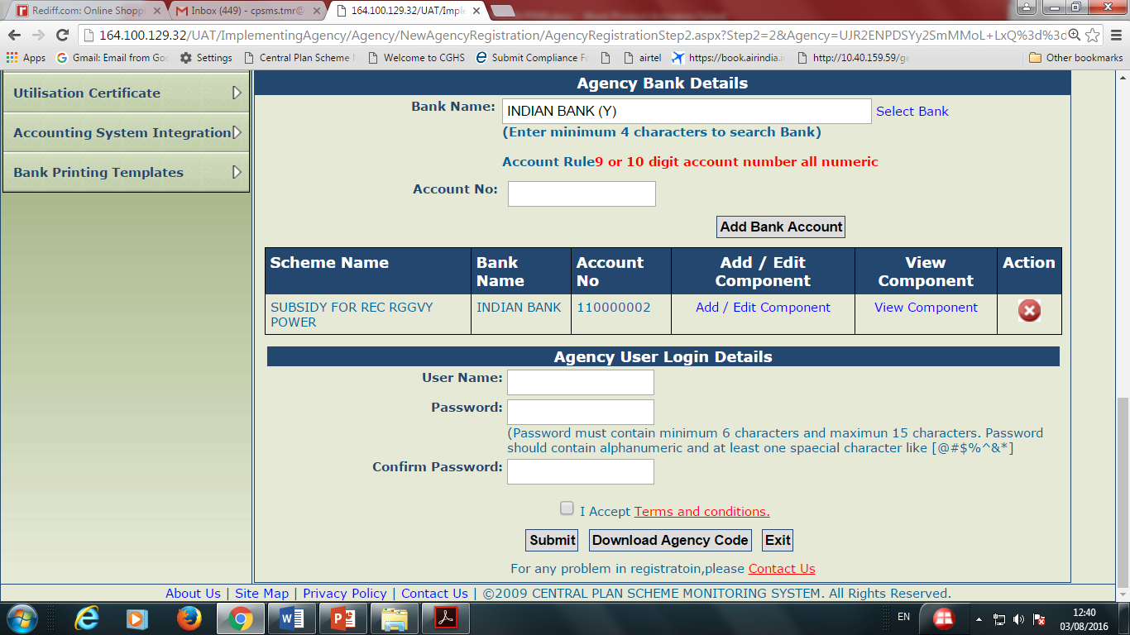

Slide 44
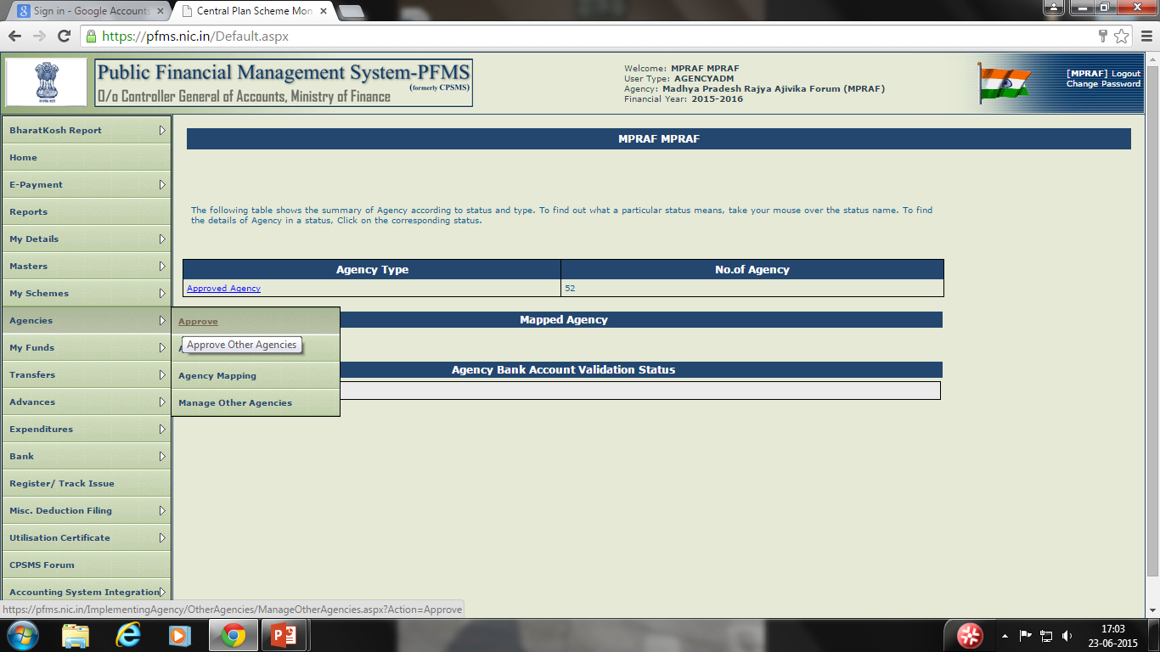

Slide 45
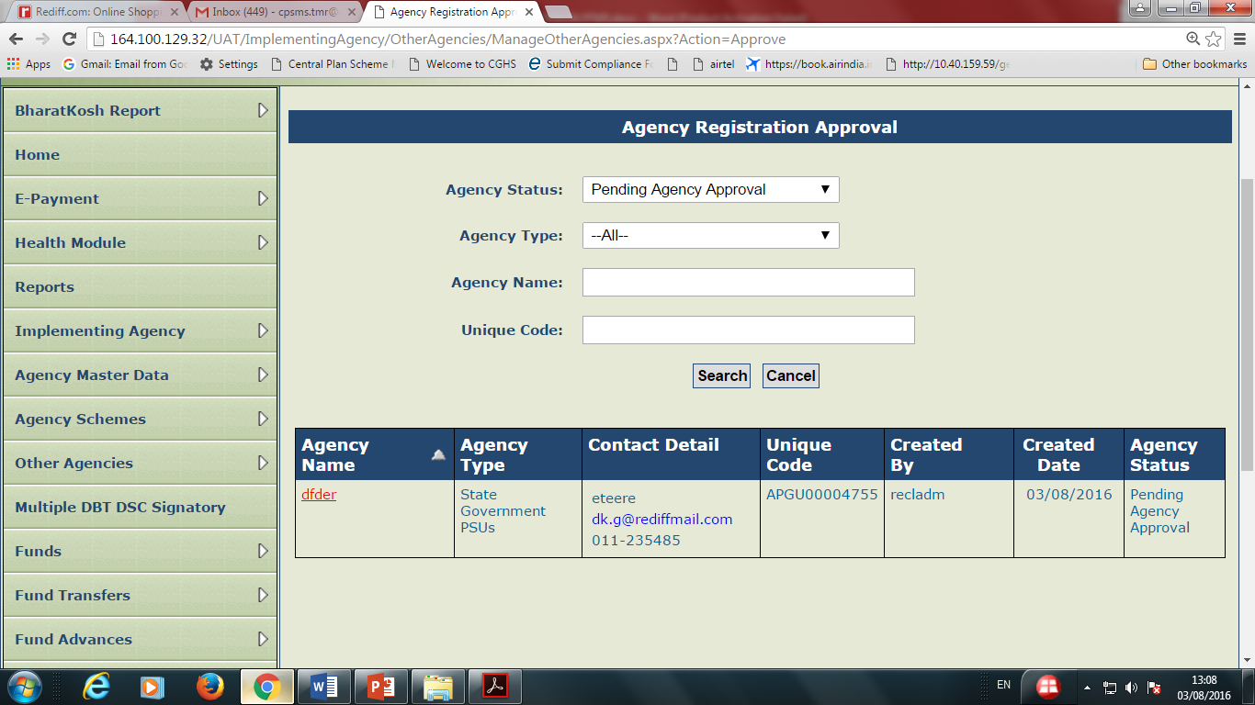

Slide 46
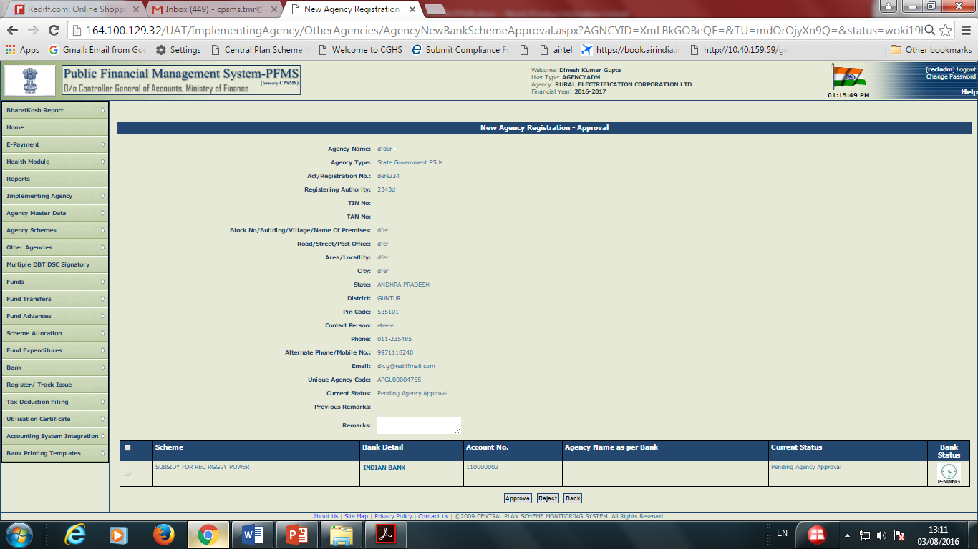

Slide 47
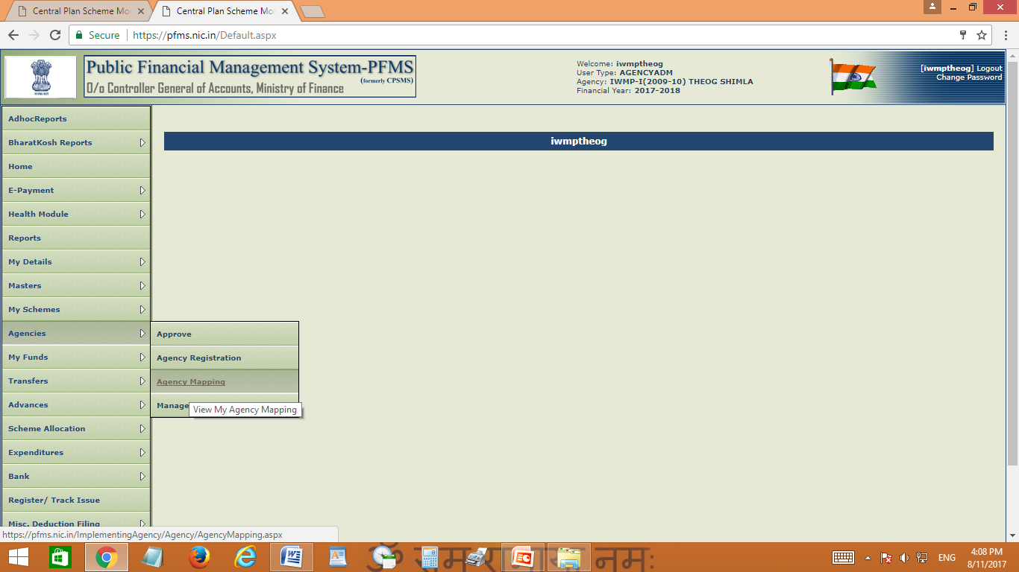
Agency Mapping

Slide 48
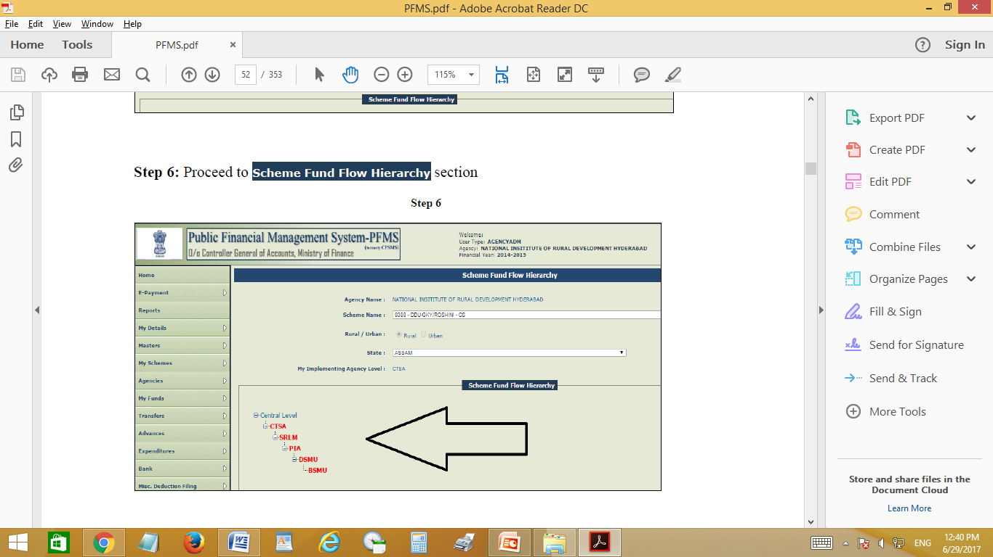

Slide 49
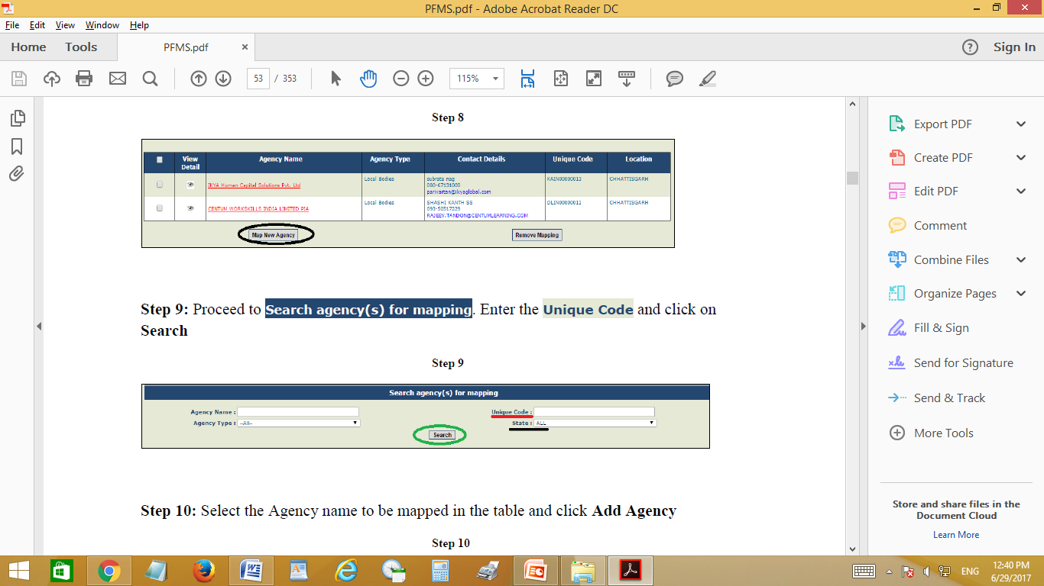

Slide 50
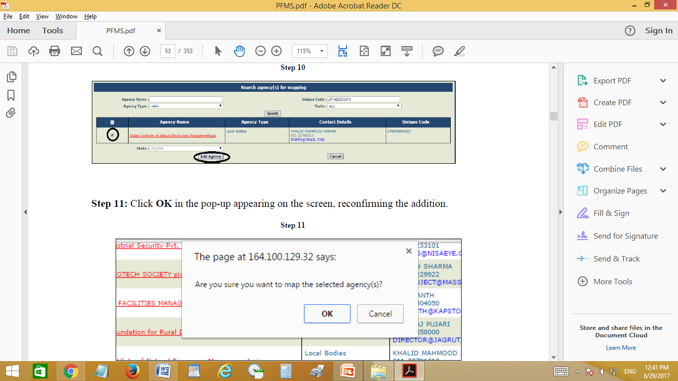

Slide 51
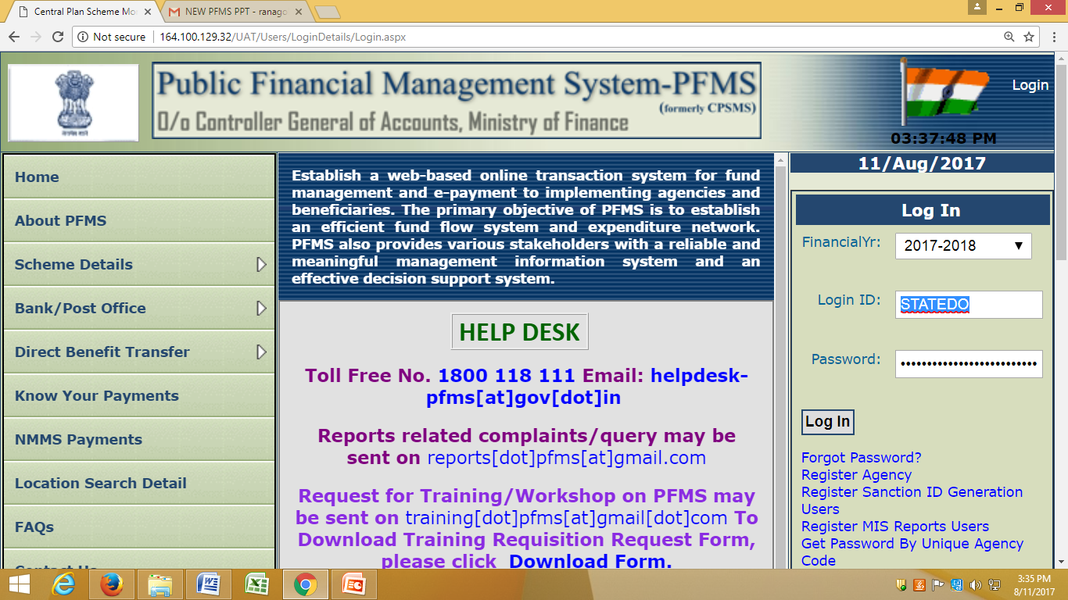
Entering of Opening Balance
Login DO

Slide 52
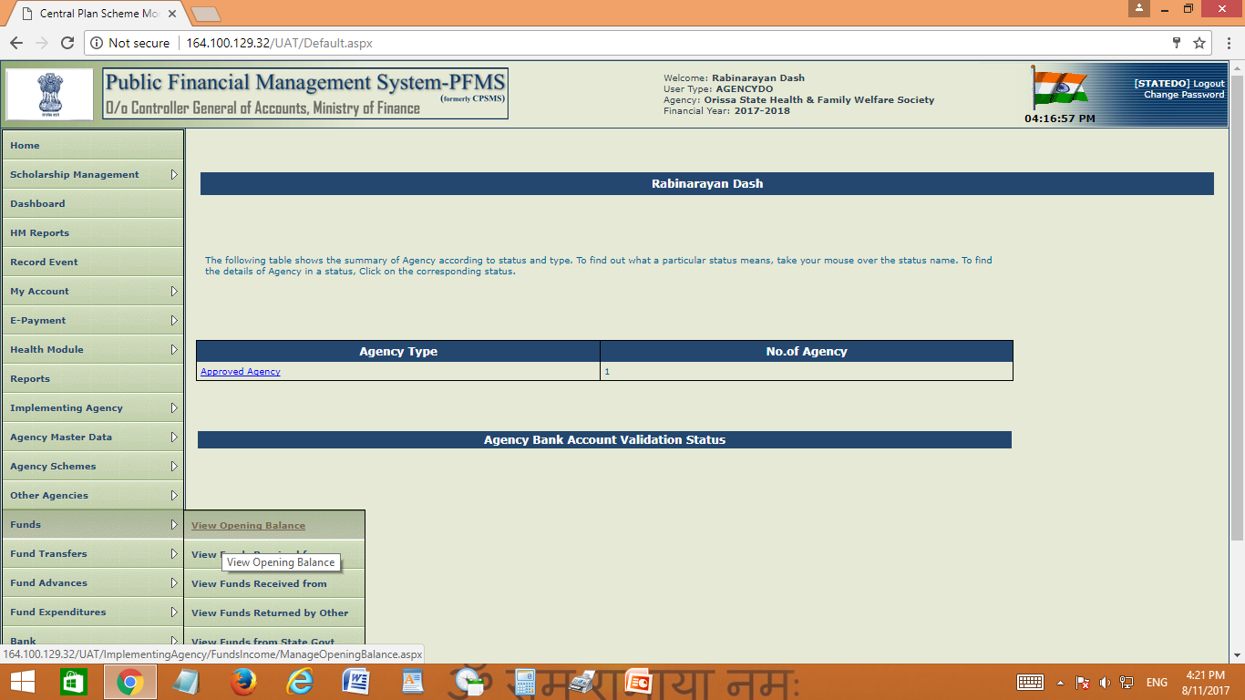

Slide 53
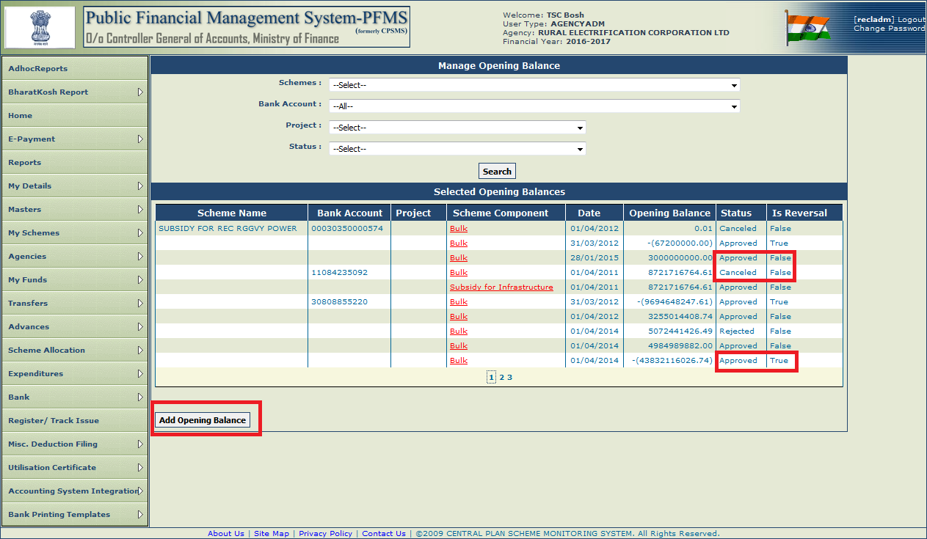
Add Opening Balance by Agency ADMIN

Slide 54
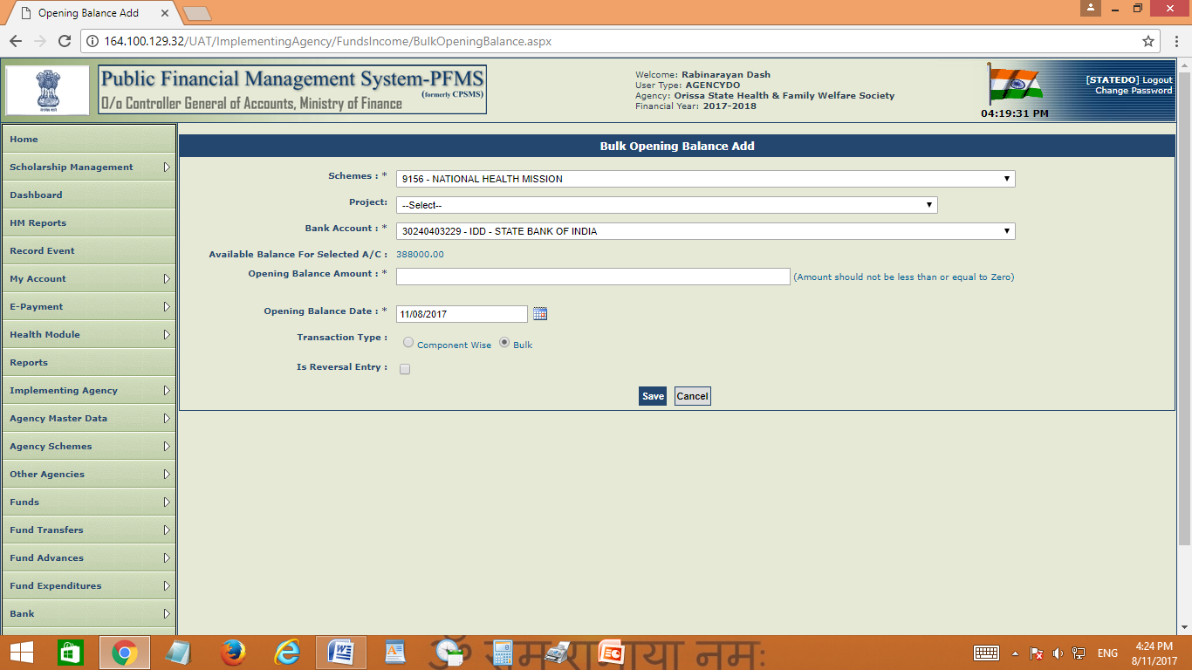

Slide 55

Approval of Opening Balance
Login DA

Slide 56
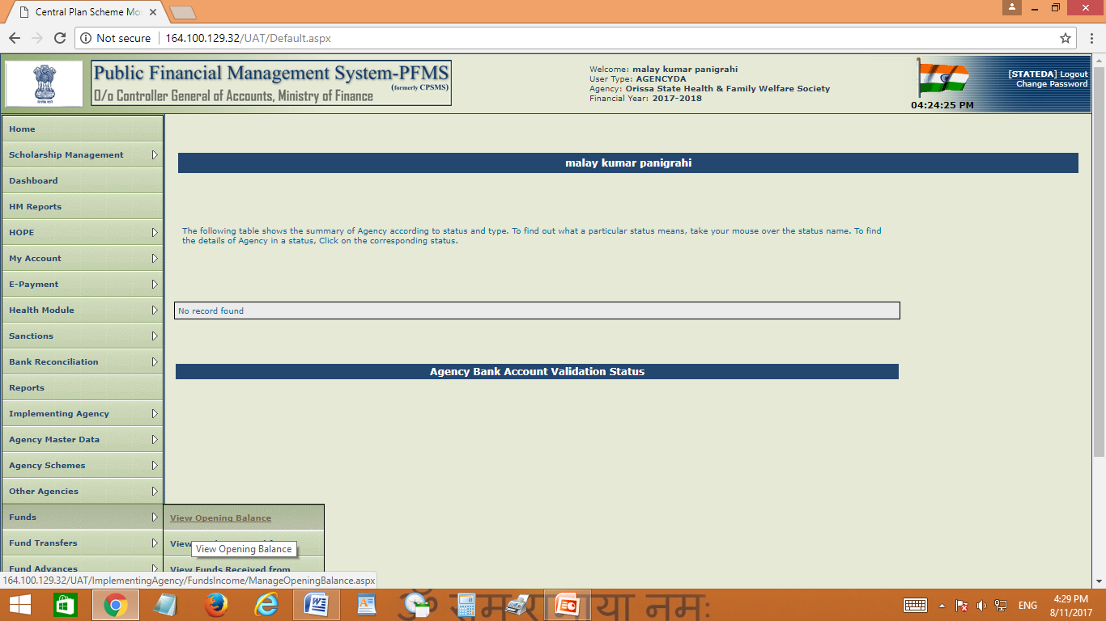

Slide 57
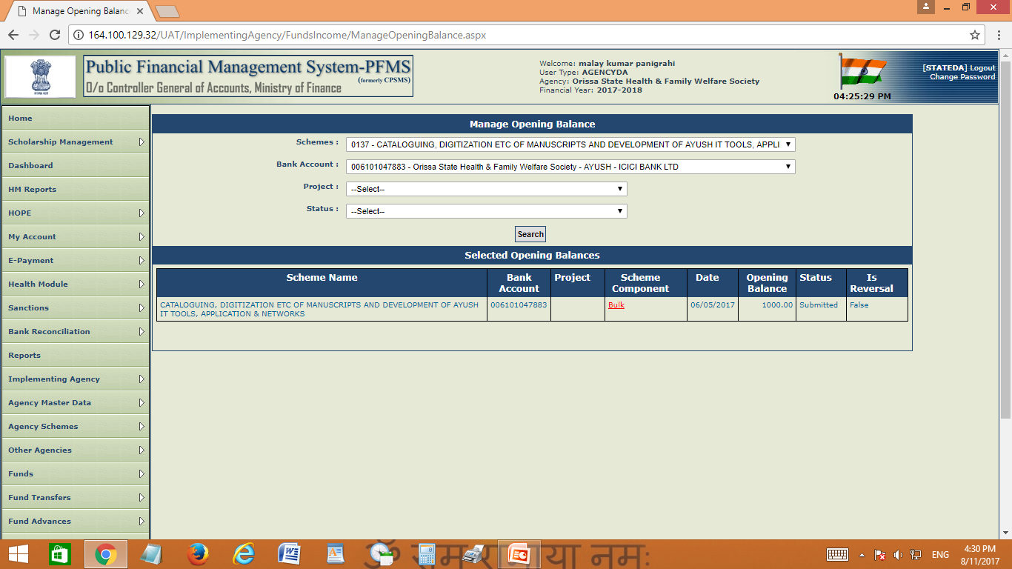

Slide 58
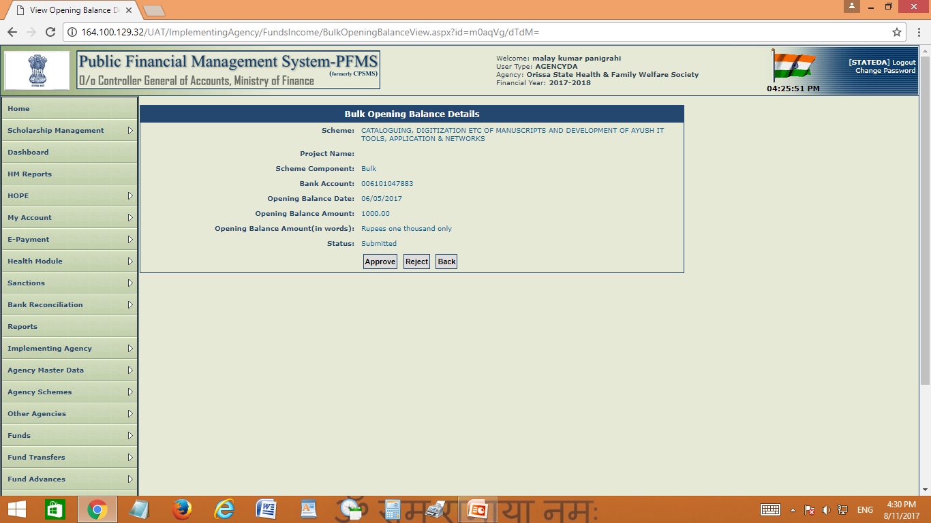

Slide 59
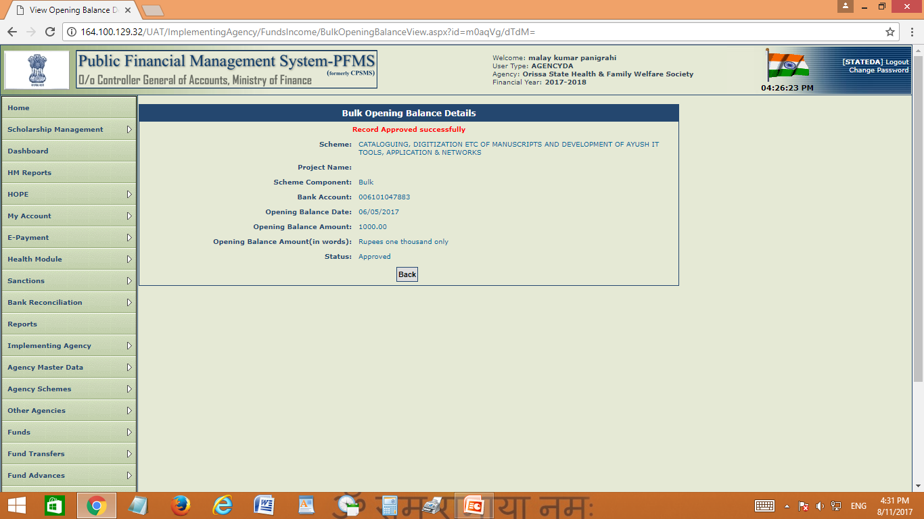

Slide 60
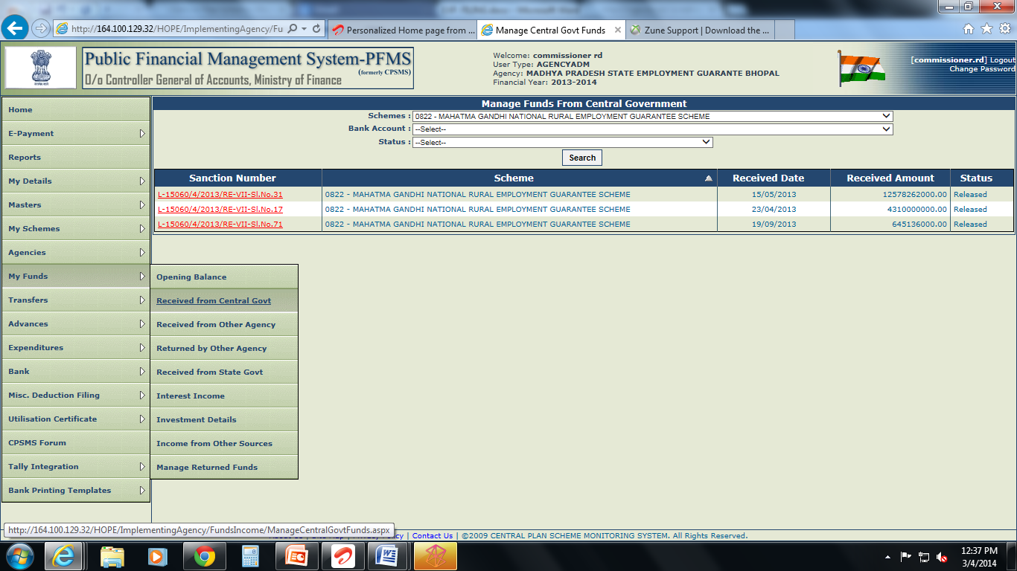
Receipts from Central Government:
As and when the fund is released by the central government directly to the agency, it become visible as detailed

Slide 61
Beneficiary /Vendor Management
      Creation of Beneficiary/ Vendor
      Upload Beneficiary / Vendor Data
      Edit Beneficiary / Vendor Data

Slide 62
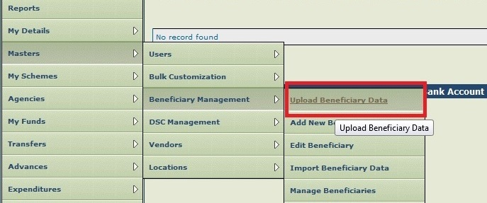
Master>Beneficiary Mgmt> Upload Beneficiary Data ( By Maker/Operator)
Upload Beneficiary Data>

Slide 63
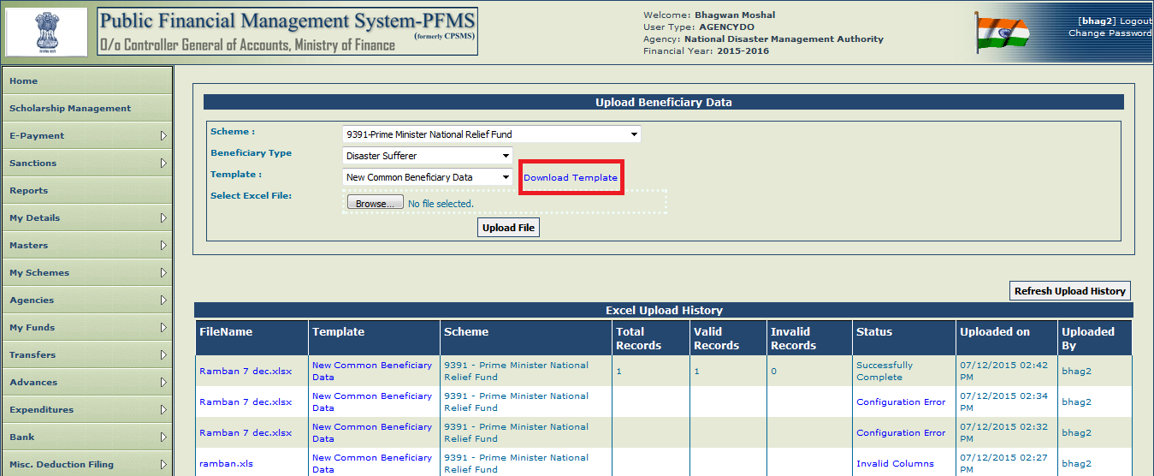
Upload Beneficiary Data – Download Template (Maker)

Slide 64
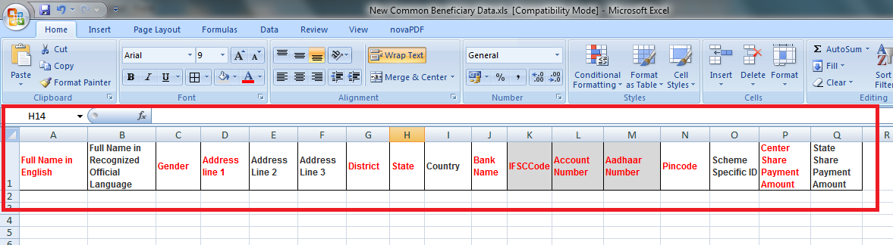
Standard Excel Template - Fields

Slide 65
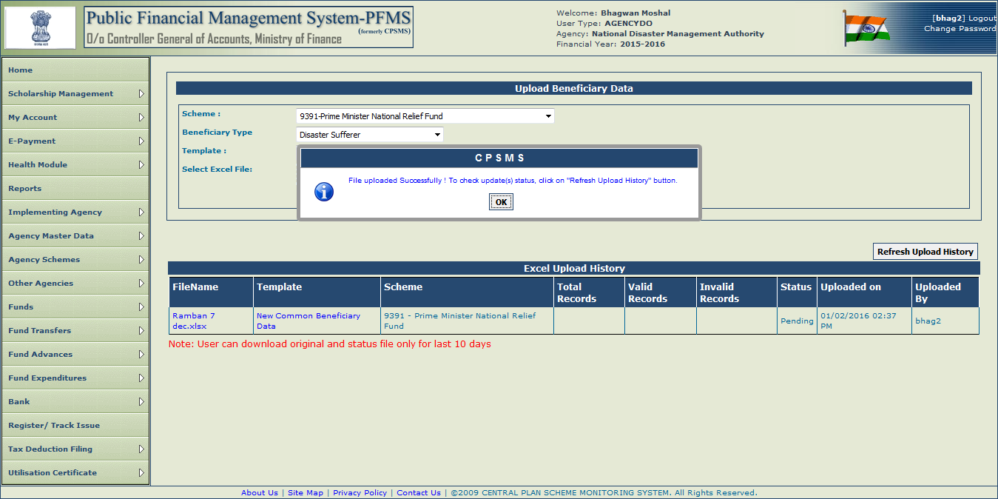
Upload Beneficiary Data – Successfully Uploaded

Slide 66
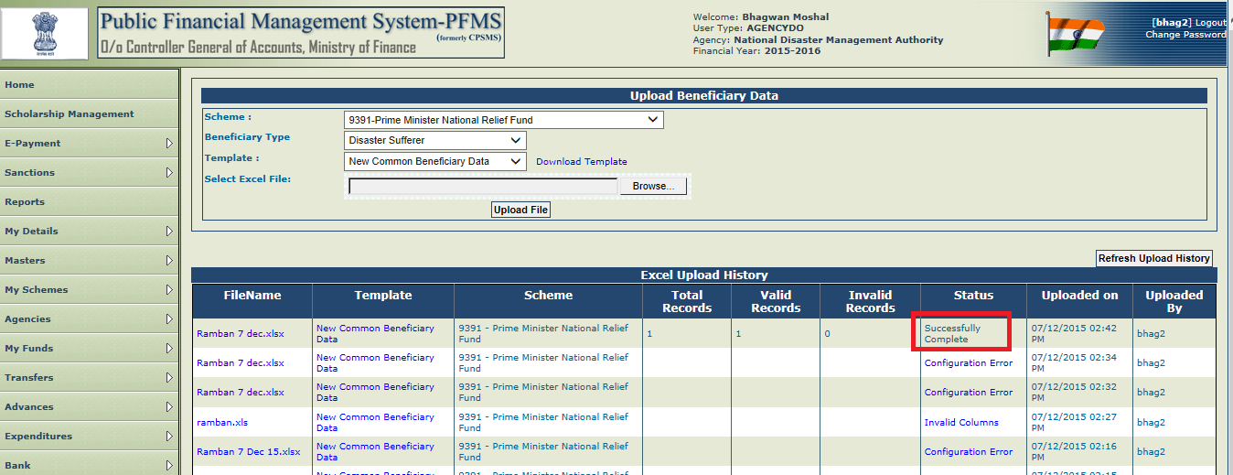
Upload Beneficiary Data – Successfully Processed

Slide 67
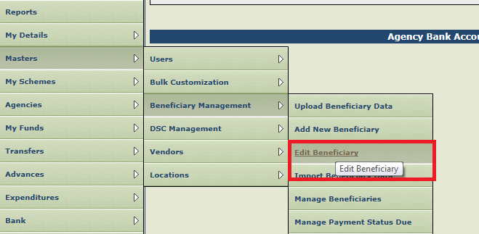
Edit Beneficiary Data (Maker)

Slide 68
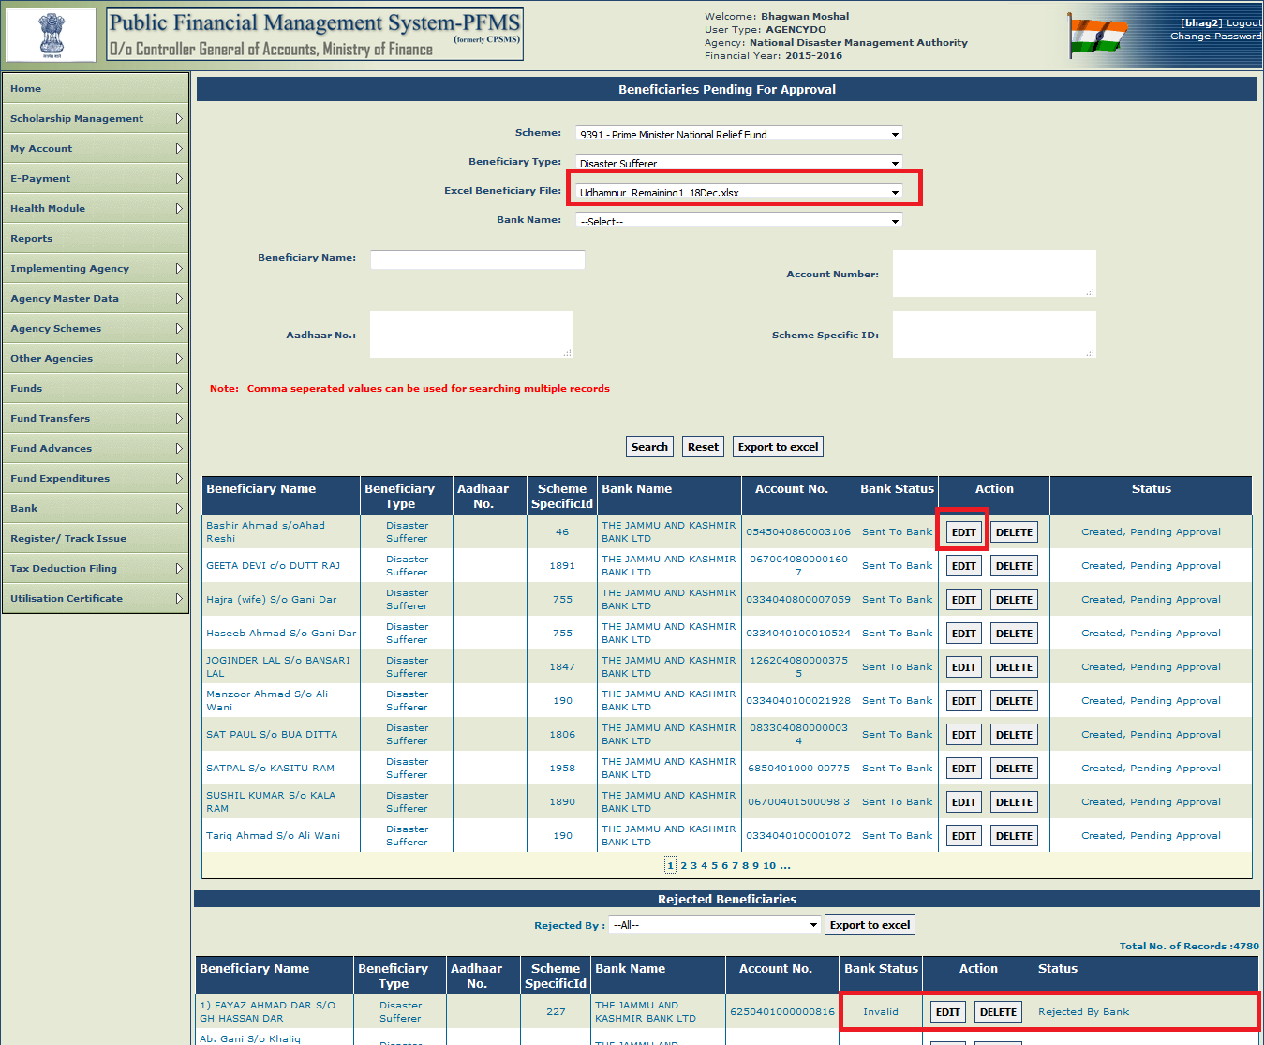
Edit Beneficiary Data

Slide 69

Edit Beneficiary – Update Beneficiary

Slide 70

Masters>Beneficiary Mgmt.>Approve Beneficiary

Slide 71

Edit Beneficiary Data-Approval (Checker)

Slide 72

Search vendor if created by others

Slide 73


Create vendor if not found

Slide 74

How to edit vendor-click name

Slide 75

Click on edit button and update

Slide 76

Account activation for e-payment

Slide 77

Select scheme and account and search

Slide 78

Select account activation type

Slide 79

Bank account will be activated automatically

Slide 80

FOR DEACTIVATION OF BANK ACCOUNT
Login – agency admin
Go To - Agency Scheme – Deactivate scheme/bank account

Slide 81

ADD NEW SCHEME
LOGIN – agency admin
Go to –Agency Scheme – Register new agency scheme

Slide 82

Bulk customization

Slide 83

Bulk customization can be done for expenditure, advance and transfer separately

Slide 84
EAT ( EXPENDITURE ADVANCE TRANSFER )

Slide 85

EXPENDITURE

Slide 86


Slide 87


Slide 88


Slide 89


Slide 90


Slide 91


Slide 92


Slide 93

FOR APPROVAL OF EXPENDITURE

Slide 94


Slide 95


Slide 96


Slide 97

ADVANCE

Slide 98


Slide 99


Slide 100


Slide 101


Slide 102


Slide 103

FOR APPROVAL OF ADVANCE

Slide 104


Slide 105


Slide 106


Slide 107

Tax Deduction Filling Entry
Login DO

Slide 108


Slide 109


Slide 110

Interest Income

Slide 111


Slide 112

For Approval of interest income entry
Login DA

Slide 113


Slide 114


Slide 115


